Slide 1
Santiago de Chile’s food venues Clusterization
Camilo Fuentes Moenne
January 2020

Slide 2
Introduction and Problem
Very recent social crisis in Chile affecting a large amount of little businesses.
There has never been a categorization of how the different communes behave in terms of food venues preferences. This investigation will propose a method to group and assign preferences to the group of communes.
Goal:
The results of this investigation can be used to suggest possible expansion or relocation for food venues based on the popularity of their category in a group of communes.

Slide 3


Data Acquisition
Foursquare for the venues information
Public data for commune geospatial location.

Slide 4
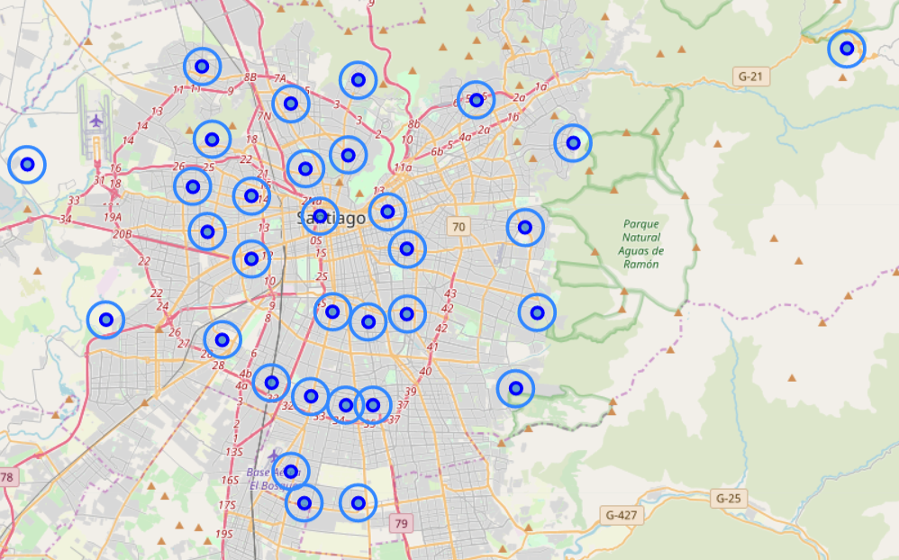
Defining initial radiuses and heuristic:
1 km radius
Increses until reaches 10 venues per commune.

Slide 5
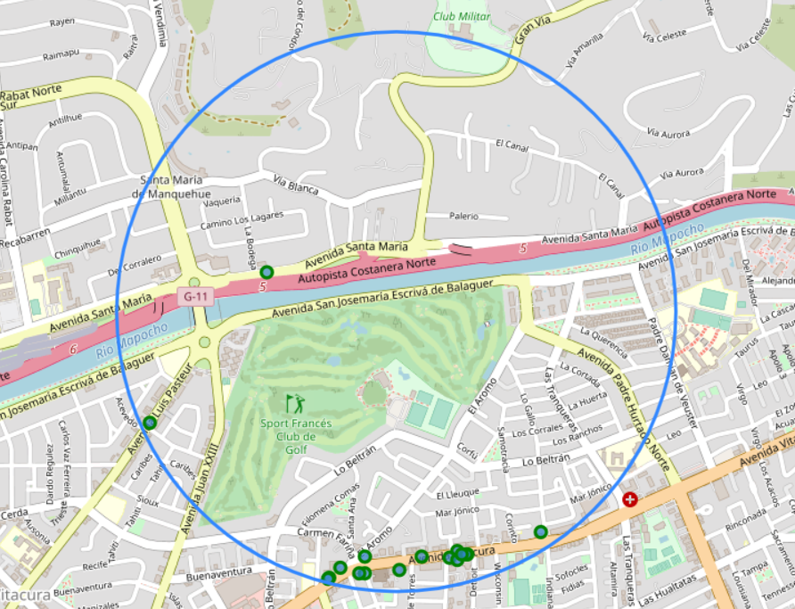
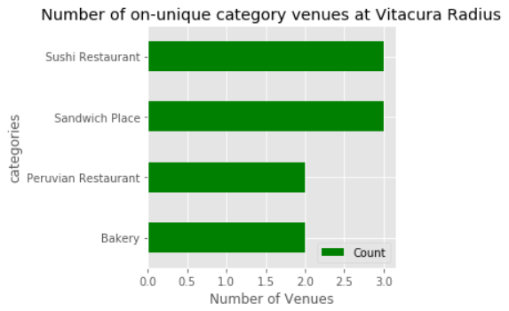
Test Sample: Vitacura

Slide 6
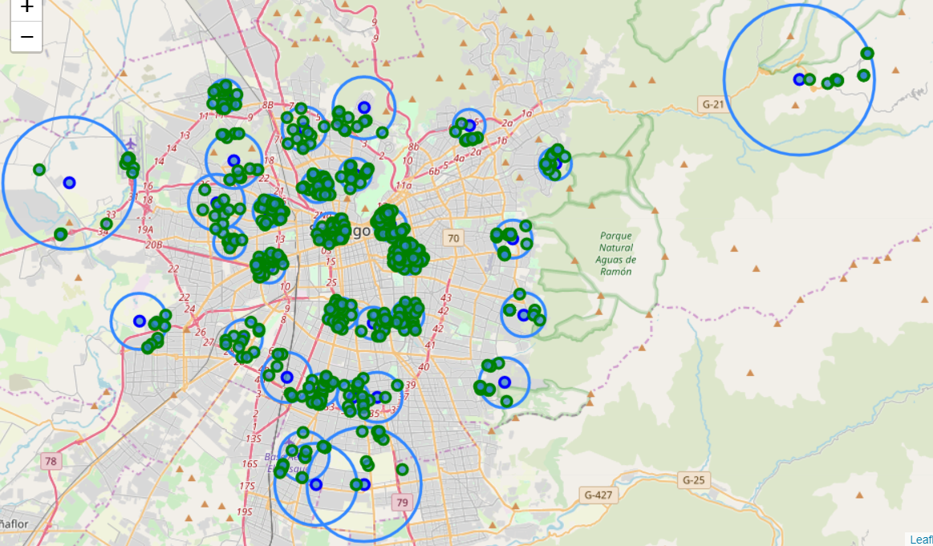
Complete Sample Overview with final radiuses:

Slide 7
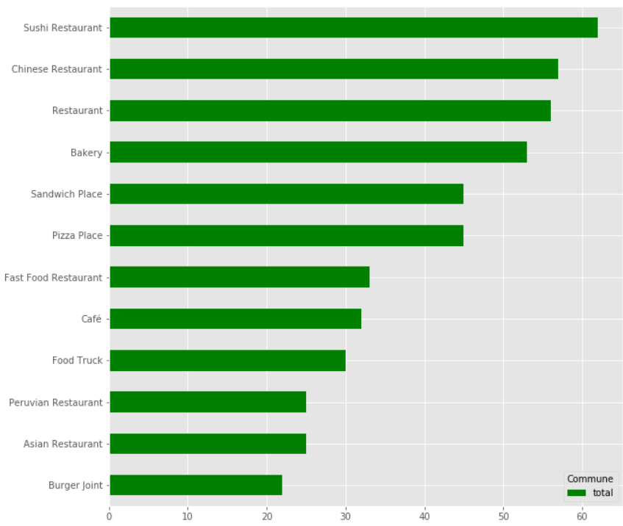
Complete Sample Overview

Slide 8
Clusterization using K-Means
Use the top 3 most popular venues categories to cluster the communes in Santiago.
Use elbow method to evaluate the optimal number for k.

Slide 9
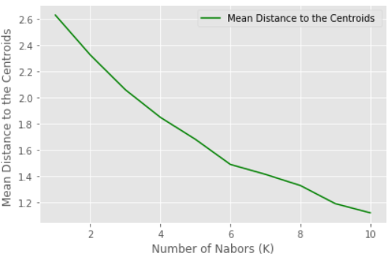
K-Means for clusteirng
Elbow method shows the optimal k is 6.

Slide 10
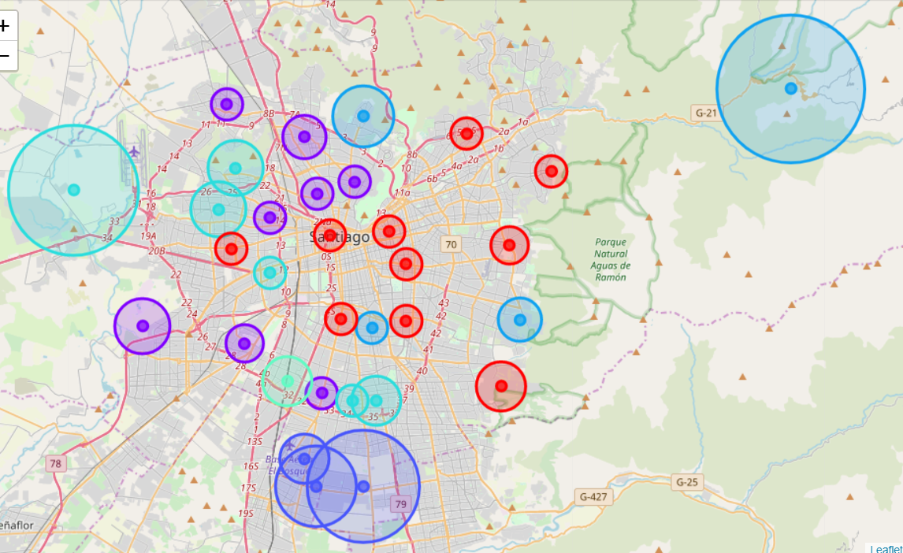
Clusterization Results

Slide 11
Conclusions
Good initial approach but several areas uncovered.
Limitations due to Foursquare’s standard user.
Areas succesfully clustered based on initial approach.
Suggestions
Try other geospatial points such as neighborhoods or more defined comunnal shapes.
Investigate other types of venues.
Investigate the influence of category in the survival of a business after placement.

